Slide 1
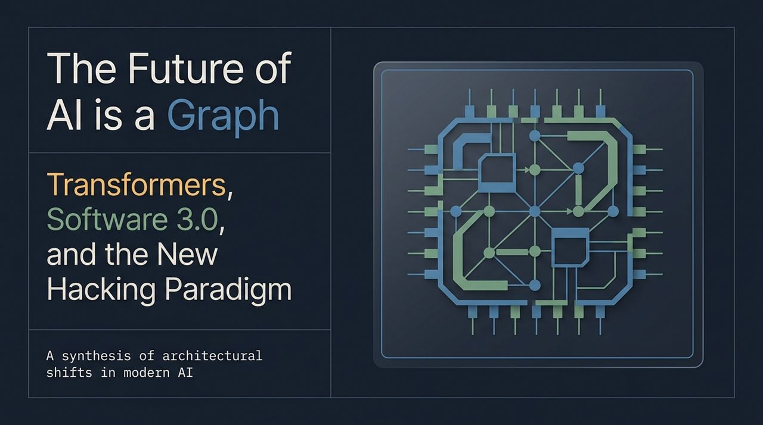
Notes:
Opening: Good morning/afternoon, everyone. Today, we are exploring a fundamental transformation in how software is created, executed, and scaled. Historically, software engineering was defined by writing explicit logic line by line. Today, we stand at the intersection of modern deep learning, the Transformer architecture, and natural language interfaces.
Key Visuals/Points on Slide: The graph chip representation; the subtitle covering Transformers, Software 3.0, and the new hacking paradigm.
Elaboration: In this presentation, we synthesized a decade of architectural shifts—from manual feature engineering, to data-driven deep learning, and finally to natural language orchestration. We will look under the hood of Large Language Models (LLMs) to see why they act less like glorified text predictors and more like reconfigurable, runtime computers.
Transition Cue: To understand where we are going, let’s begin with a quote that encapsulates this new paradigm.
https://www.youtube.com/watch?v=Rlk0GLRWwTI

Slide 2
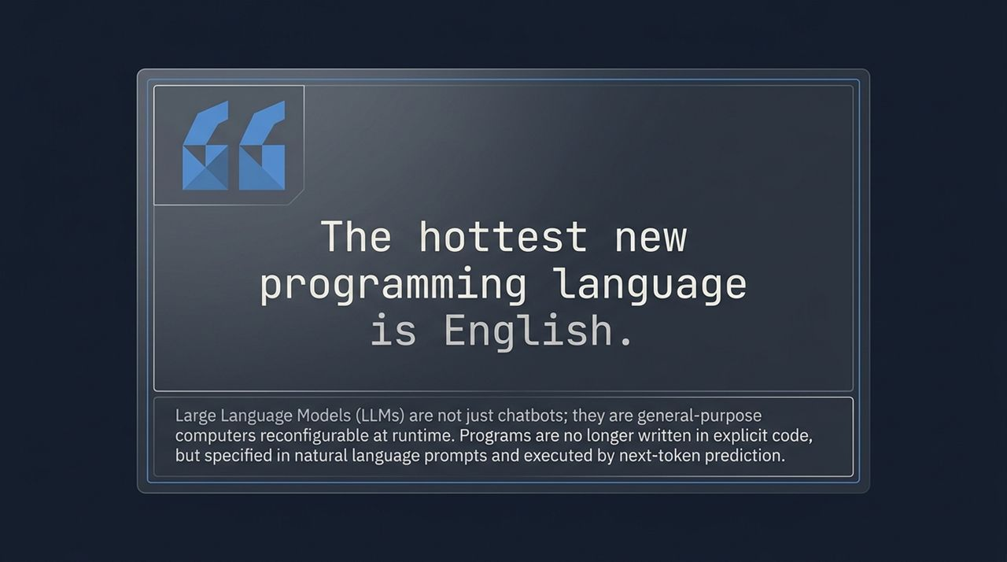
Notes:
Key Point: The fundamental takeaway of this slide is that LLMs are not merely conversational chatbots; they are general-purpose computers reconfigurable at runtime.
Script: For seventy years, to program a computer, you had to speak the computer's native language—from assembly up to C++, Python, or Java. Today, the primary interface for software creation is switching to natural English.
Technical Depth: Underneath the hood, these models process text through next-token prediction. But when you train a Transformer with over a hundred billion parameters across massive datasets, next-token prediction ceases to be a simple text auto-complete. It becomes a mechanism for simulating logical deduction, state tracking, and instruction following.
Real-world Context (Ref to Video): As Andrej Karpathy noted during his keynote, when you scale up these models, you aren't just building another classifier; you are instantiating an environment that processes text programs passed in as prompts.
Transition Cue: Let's trace how we arrived here by categorizing the three major software eras.

Slide 3
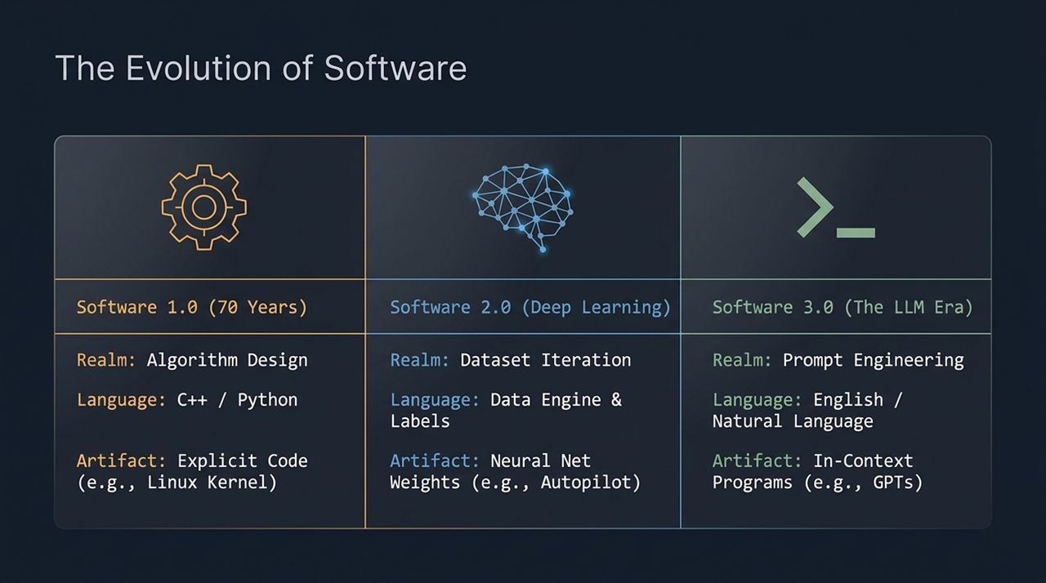
Notes:
Software 1.0 (Algorithm Design): For roughly 70 years, we resided in Software 1.0. Humans designed explicit algorithms using languages like C++ or Python. The primary artifact produced was explicit code, such as the Linux Kernel or database engines.
Software 2.0 (Dataset Iteration / Deep Learning): Around 2012–2017, Software 2.0 emerged. Here, humans stopped writing code for complex visual or auditory recognition tasks. Instead, we iterated on the 'Data Engine'—accumulating, cleaning, and labeling datasets. The compiler became optimization via Stochastic Gradient Descent (SGD), and the resulting artifact was neural network weights (e.g., Tesla Autopilot, Whisper, or image classifiers).
Software 3.0 (Prompt Engineering / In-Context Era): Now, in Software 3.0, the realm shifts to Prompt Engineering. The primary language is natural language (English). The artifact is no longer static code or updated model weights, but an in-context program executed dynamically inside the model's activations.
Key Insight: Note that 3.0 does not destroy 1.0 or 2.0; rather, they layer on top of each other. You still need millions of lines of C++ and Python (1.0) to compile and run the neural network infrastructure (2.0) that powers the LLM (3.0).
Transition Cue: Let's examine a concrete demonstration of Software 3.0 in action.

Slide 4
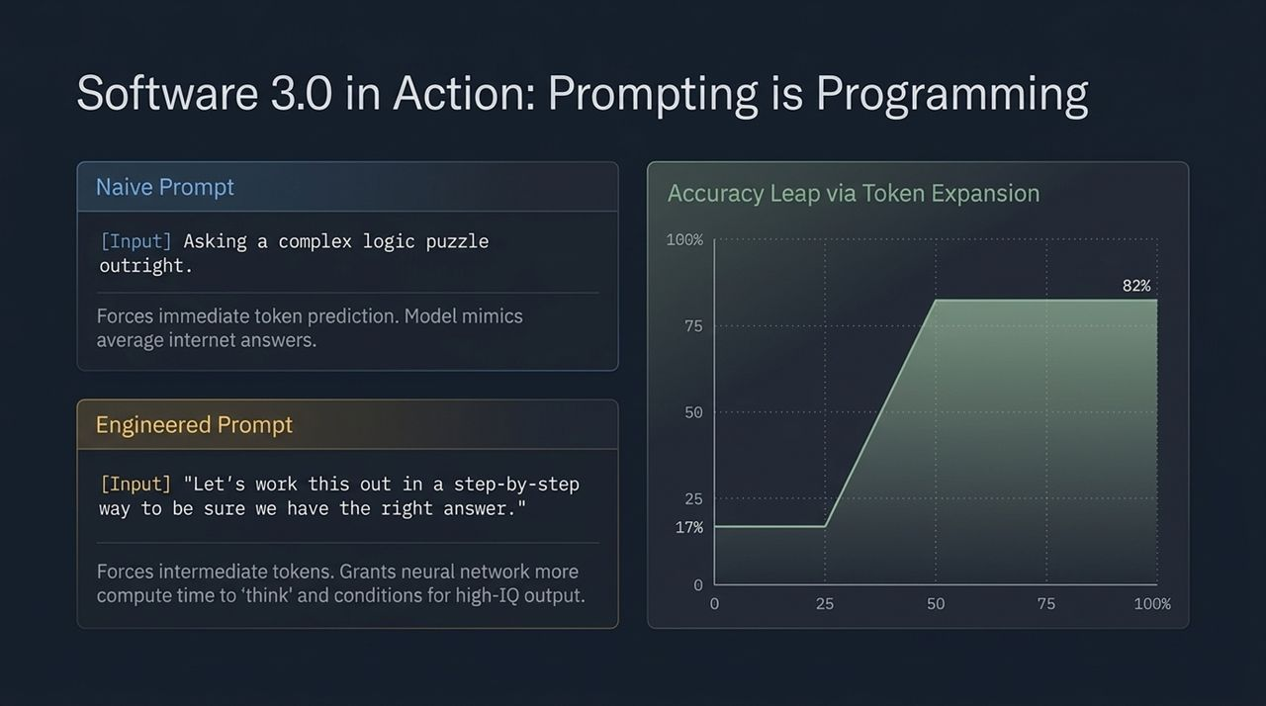
Notes:
Slide Breakdown: Highlight the jump from 17% accuracy to 82% accuracy on complex logic benchmarks purely through prompt formulation.
Script: In traditional software, if a function fails, you rewrite the algorithmic logic. In Software 3.0, if an LLM fails, you re-architect the prompt. Look at this benchmark: when presented with a complex word puzzle or logic query, asking the model outright for the answer forces it to predict the final token immediately.
Why Naive Prompting Fails (17% Accuracy): The model only gets a fixed amount of compute per output token. Trying to jump straight to the answer mimics average, low-effort internet text, resulting in a low 17% accuracy rate.
Why Token Expansion Works (82% Accuracy): When you append instructions like 'Let's work this out in a step-by-step way to be sure we have the right answer,' you force the model to emit intermediate tokens. Each intermediate token gives the neural network an additional forward pass of computation to 'think'. You are literally purchasing more compute cycles at runtime, conditioning the network to emulate an expert-level, high-IQ reasoning process.
Transition Cue: This capability allows LLMs to simulate far more than simple mathematical steps—they can emulate full operating environments.

Slide 5
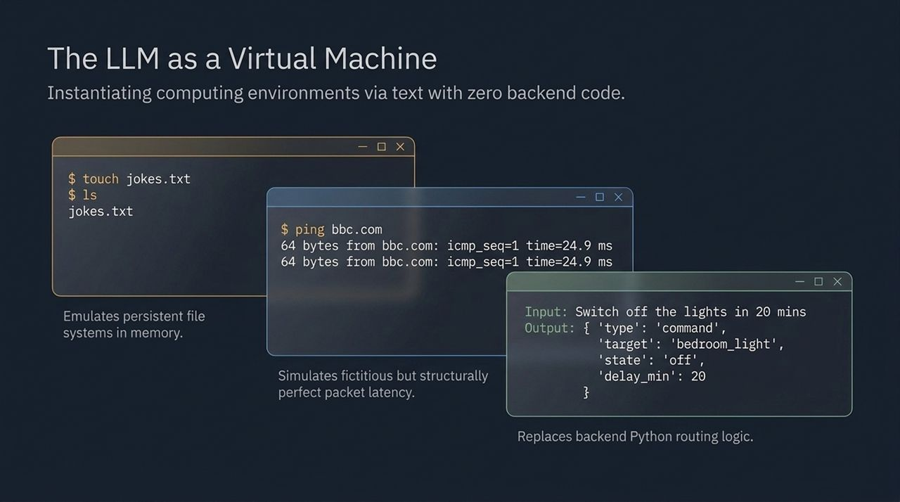
Notes:
Key Vignettes from Video:
Linux Terminal Emulation: In a famous experiment, an LLM was prompted to act as a Linux terminal. When commands like touch jokes.txt or ls were typed, the model hallucinated a completely consistent, in-memory file system. Reading back the file returned the exact text written earlier.
Network Packet Latency: Executing ping bbc.com produced structurally perfect packet responses, complete with realistic round-trip times (e.g., 24.9 ms), despite no actual network hardware or connection existing.
Smart Home API Routing: When told 'Switch off the lights in 20 mins', the model didn't just reply conversationally; it outputted a clean JSON command object with 'target': 'bedroom_light', 'state': 'off', and calculated the delayed timestamp. It effectively replaced complex backend Python routing logic purely through prompt constraints.
Takeaway: This proves LLMs are simulators capable of holding state, parsing intent, and converting unstructured natural language into structured program execution.
Transition Cue: So what is a GPT at an architectural level? Let's formalize this hardware analogy.
Slide 6: Synthesis: Wh

Slide 6
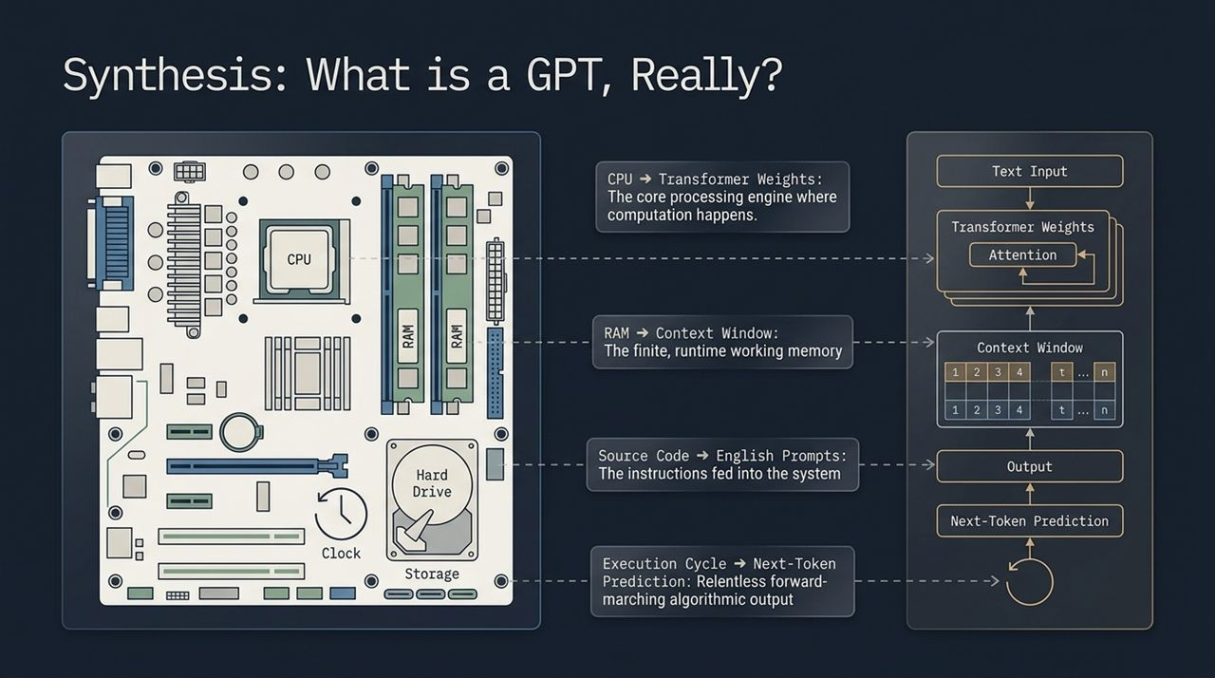
Notes:
Hardware Analogy Mapping:
Transformer Weights = CPU: The fixed weights derived from training act as the core execution engine where raw compute occurs.
Context Window = RAM: The finite token context window (e.g., 2K, 8K, 32K tokens) acts as high-speed working memory. Anything outside this window is effectively forgotten unless re-injected.
English Prompts = Source Code: The prompt string represents the user application program being loaded into memory.
Next-Token Prediction = Execution Clock Cycle: The continuous forward-pass loop generating token-by-token output serves as the relentless algorithmic clock cycle.
Summary: When you view GPT through this lens, you realize we haven't built an database search engine; we have built a general-purpose, text-driven CPU that evaluates instructions dynamically in activation space.
Transition Cue: Now let's step back and look at how the entire field of AI unified around a single architecture to make this possible.

Slide 7
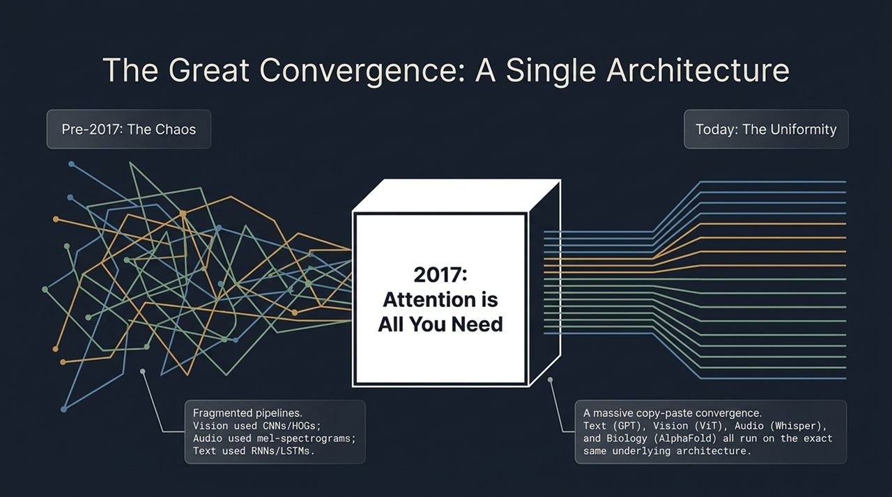
Notes:
Pre-2017 (The Fragmented Era): A decade ago, AI was heavily siloed. If you worked in Computer Vision, you studied Convolutional Neural Networks (CNNs) and HOG features. Audio researchers used mel-spectrograms and HMMs. NLP researchers studied Recurrent Neural Networks (RNNs) and LSTMs. Insights in one field rarely translated to another.
Post-2017 (The Transformer Convergence): Following the 2017 landmark paper 'Attention Is All You Need', a massive consolidation occurred. Today, Text (GPT), Vision (Vision Transformers / ViT), Speech/Audio (Whisper), Reinforcement Learning (Decision Transformer), and Biology (AlphaFold) all run on the exact same underlying architecture.
Significance: This means improvements in core Transformer scaling or hardware acceleration instantly benefit every domain across the entire AI landscape simultaneously.
Transition Cue: Why did the Transformer defeat every rival architecture? There are three secret drivers.

Slide 8
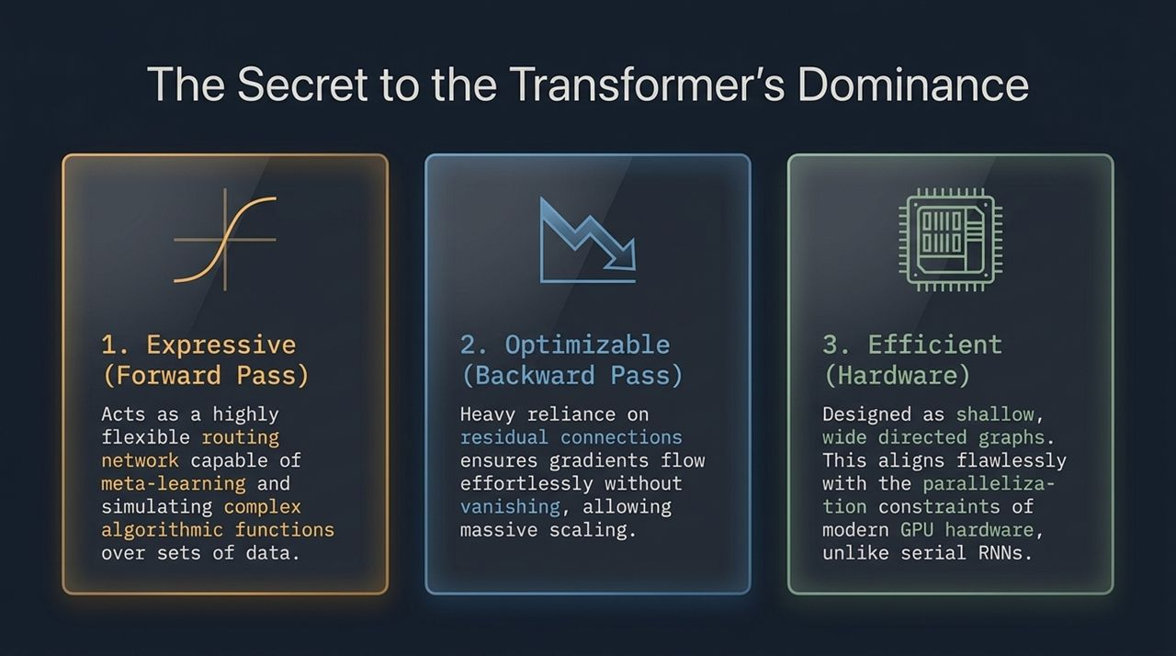
Notes:
1. Expressive (Forward Pass): In the forward pass, self-attention acts as a flexible, data-dependent routing network. It enables dynamic meta-learning and simulates complex algorithmic functions over arbitrary input sets.
2. Optimizable (Backward Pass): In the backward pass, heavy reliance on residual skip-connections and layer normalization guarantees that gradients flow smoothly back through hundreds of layers without vanishing or exploding. This makes scaling up model depth remarkably stable.
3. Efficient (Hardware Realities): Crucially, a Transformer's computational graph represents a shallow, wide directed graph. Unlike serial RNNs—which must process token 1, then token 2, sequentially—Transformers compute operations across whole sequences simultaneously. This maps perfectly to the parallel architecture of modern GPUs.
Karpathy Insight: If you want to scale deep learning, hardware efficiency isn't an afterthought—it is the primary constraint. The Transformer won because it was designed to maximize GPU utilization.
Transition Cue: To achieve this hardware efficiency across different data types, Transformers treat all inputs not as spatial grids, but as sets.

Slide 9
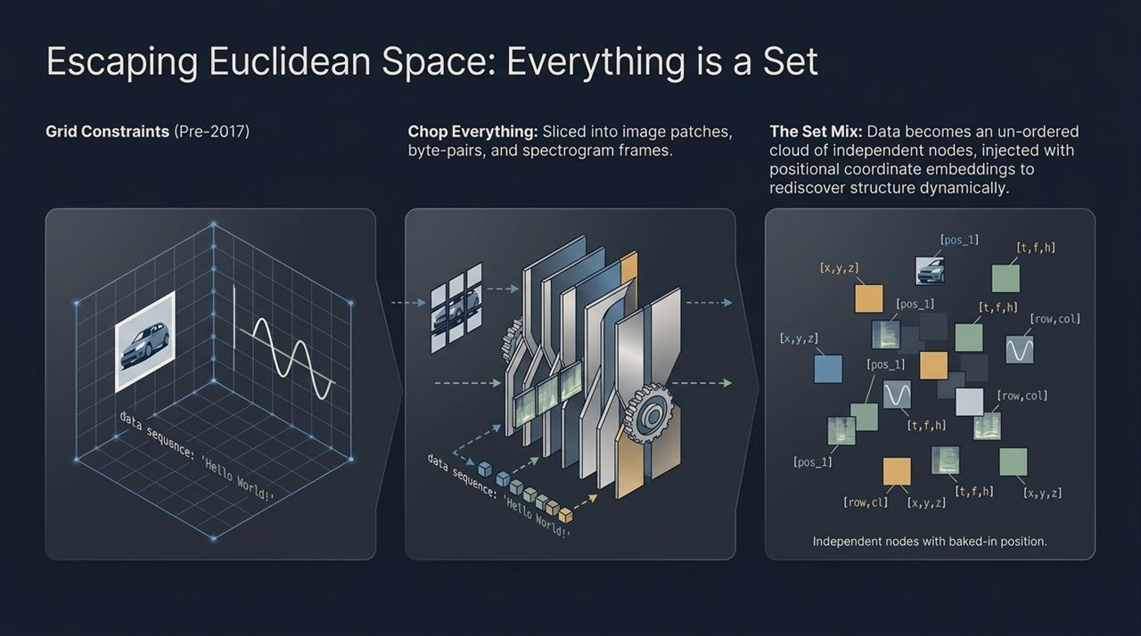
Notes:
Breaking Grid Constraints: Prior to 2017, neural networks were tied to Euclidean geometry—2D grids for images, 1D sequences for audio. Transformers break free from spatial constraints by breaking data down into sets of discrete tokens.
Data Flattening Process:
Images: Sliced into $16×16$pixel patches (Vision Transformers).
Text: Segmented into byte-pair encoded tokens.
Audio: Cut into mel-spectrogram time/frequency frames.
Sensors/Radar: Processed as discrete feature vectors.
The Set Cloud & Positional Embeddings: Once chopped, the data becomes an unordered cloud of independent nodes. Because attention by itself is permutation-invariant (it treats all nodes equally), we inject positional coordinate embeddings directly into each token vector. The network then dynamically reconstructs geometric relationships during processing.
Transition Cue: Let's now step inside a Transformer Block to see how these nodes communicate.

Slide 10
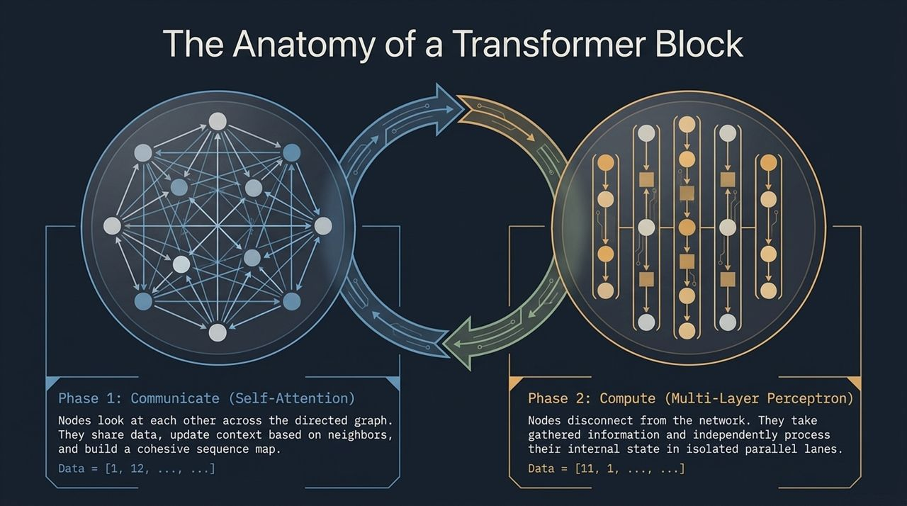
Notes:
Phase 1: Communicate (Self-Attention / Multi-Head Attention): In this phase, nodes across the directed graph talk to one another. They exchange contextual information, update their state based on neighboring nodes, and form a unified map of the sequence. Note that during communication, no heavy individual token reasoning is executed—data is simply aggregated.
Phase 2: Compute (Multi-Layer Perceptron / Feed-Forward): In this phase, all cross-node communication links are severed. Each node takes the aggregated context it just received and independently processes its internal representation through a multi-layer neural network. This happens in isolated, parallel computational lanes across the GPU.
Interleaved Cycle: A deep Transformer is simply a stack of these repeating blocks: Communicate, Compute, Communicate, Compute.
Transition Cue: Let's zoom into Phase 1 to see the exact mathematics behind message passing on graphs.

Slide 11
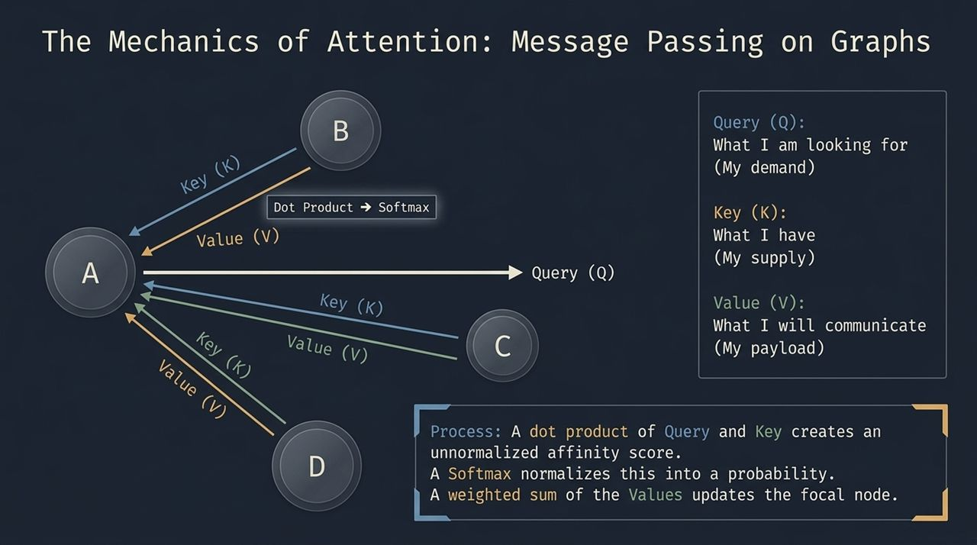
Notes:
Analogy Breakdown:
Query ($Q$): What I am looking for (the node's demand).
Key ($K$): What I possess (the node's supply label).
Value ($V$): What I will actually communicate (the node's payload).
Step-by-Step Mathematical Flow:
Dot Product: A focal node takes its Query vector and computes a dot product against the Key vectors of all incoming candidate nodes. This generates an unnormalized affinity score representing relevance.
Softmax: These affinity scores pass through a Softmax function, converting raw numbers into a normalized probability distribution summing to 1.0.
Weighted Sum: The focal node collects the Value payload vectors from all incoming nodes, scaled by their corresponding Softmax probability weights. The weighted sum updates the focal node's state.
Key Takeaway: This mechanism allows tokens to dynamically route information based on context rather than fixed physical locations.
Transition Cue: How does this dynamic routing allow a network to learn new tasks at runtime without updating its weights? Let's look at the two learning loops.

Slide 12
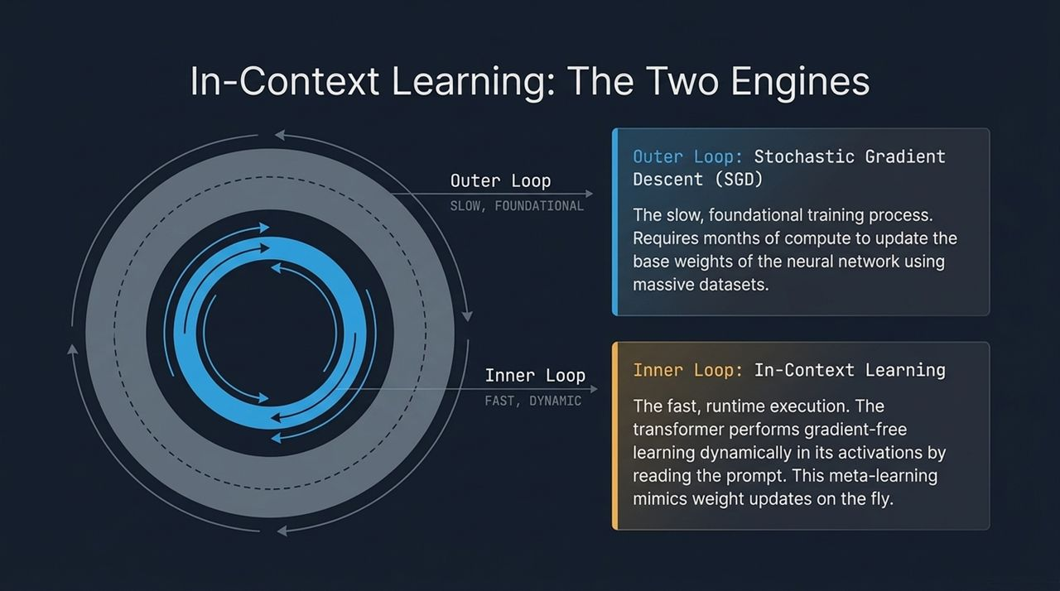
Notes:
Outer Loop: Stochastic Gradient Descent (SGD) — Slow & Foundational:
Occurs during pre-training over months using massive GPU clusters.
Modifies the static floating-point parameters (weights) of the neural network.
Builds the base 'circuitry' and world knowledge of the model.
Inner Loop: In-Context Meta-Learning — Fast & Dynamic:
Occurs live at inference time in milliseconds as the model reads your prompt.
Zero weight modifications occur. Instead, learning takes place within activation space across residual pathways.
As prompt examples are fed in, the attention mechanism dynamically adjusts internal state representations. Recent research shows this inner loop mathematically emulates implicit gradient descent running inside activation space.
Transition Cue: While in-context learning is powerful, working memory is constrained by the context window. How do we overcome this bottleneck?

Slide 13
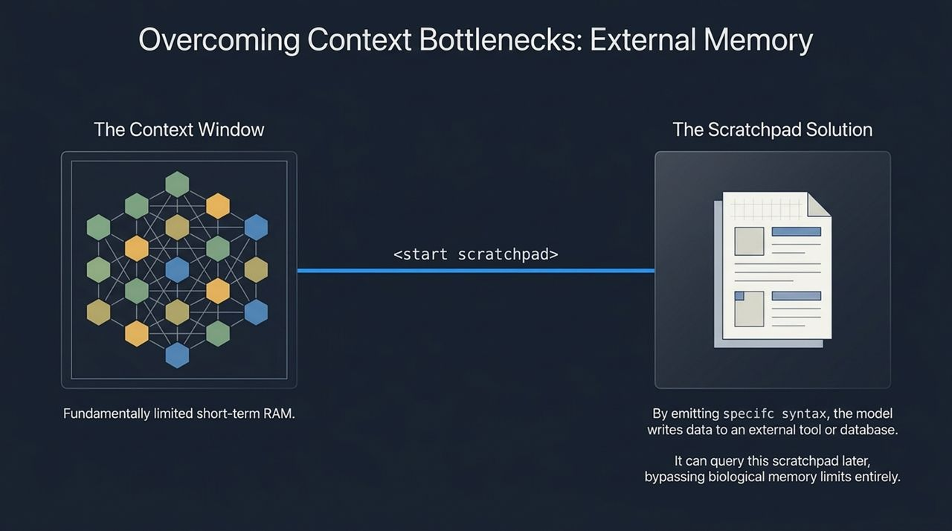
Notes:
The Short-Term RAM Problem: A Transformer's context window acts like fast system RAM. It is finite and computationally expensive to expand quadratically.
The Scratchpad Solution: To solve this, we give the model access to external memory tools via structured syntax. By emitting explicit tokens like <start scratchpad> ... <end scratchpad>, the decoding system captures intermediate reasoning, writes to external databases or tool state, and reads it back when needed.
Human Analogy: Just as humans use physical notebooks to solve long mathematical proofs rather than holding everything in active working memory, Transformers use external scratchpads and vector retrieval (RAG) to scale performance indefinitely.
Transition Cue: Looking forward, will we rely on single giant models or coordinated multi-agent systems?

Slide 14
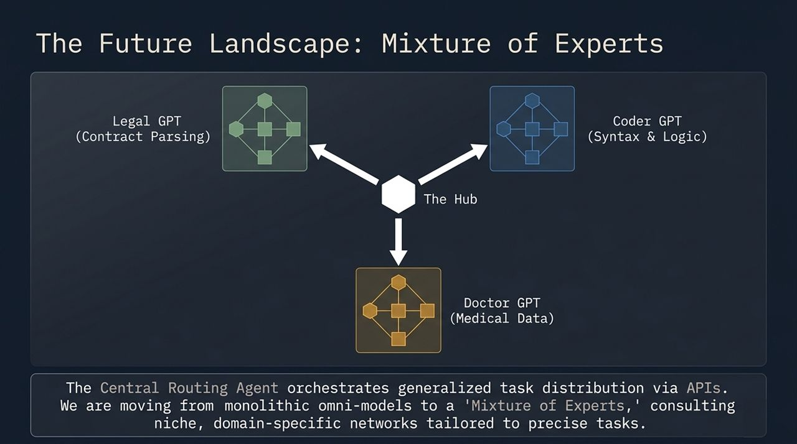
Notes:
The Monolithic Dilemma: Training a single monolithic network to master legal contracts, medical diagnoses, C++ code, and creative writing simultaneously creates parameter inefficiency and massive compute costs.
The Mixture of Experts (MoE) Architecture: The industry is shifting toward specialized expert sub-networks. In an MoE architecture, a central routing agent analyzes incoming natural language tasks and delegates them to targeted domain models:
Legal GPT: Specialized in contract parsing and case law.
Doctor GPT: Tailored for clinical diagnostics and medical literature.
Coder GPT: Optimized for syntax validation and logic synthesis.
Result: We achieve higher accuracy, lower overall latency, and far more modular engineering practices.
Transition Cue: To wrap up our technical synthesis, let's examine how this technological paradigm mirrors human biology.

Slide 15
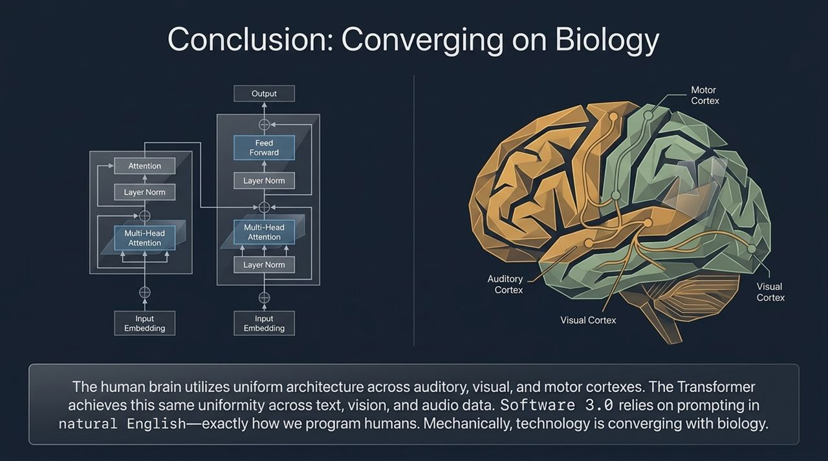
Notes:
Architectural Uniformity: In human biology, the neocortex maintains a remarkably uniform cellular structure across functional areas. The visual cortex, auditory cortex, and motor cortex share common structural blueprints, adapting to different input signals seamlessly.
Artificial Uniformity: The Transformer achieves this same biological elegance. Text, vision, audio, and motor control are processed through identical self-attention and feed-forward layers.
Software 3.0 Realization: Furthermore, Software 3.0 relies on prompting in natural English—which is precisely how humans program other humans. Mechanically and instructionally, our software engineering paradigms are converging directly onto biological principles.
Transition Cue: Let's review the complete summary diagram on slide 16.

Slide 16
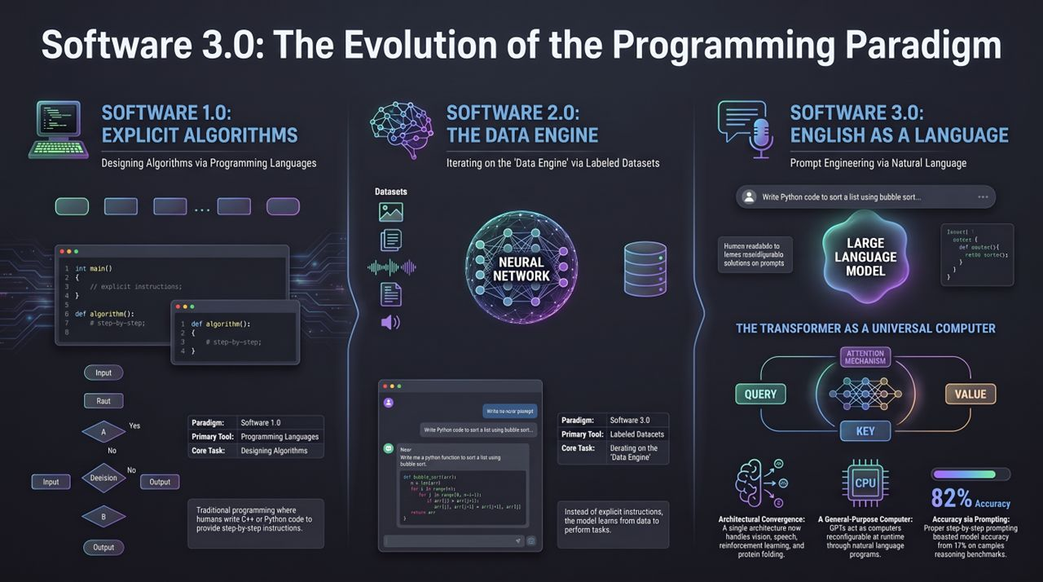
Notes:
Comprehensive Summary Breakdown:
Software 1.0 (Explicit Algorithms):
Tool: Programming Languages (C++, Python).
Core Task: Hand-crafting explicit algorithmic instructions.
Software 2.0 (The Data Engine):
Tool: Labeled Datasets & Optimization.
Core Task: Iterating on data collection, training, and compiling weights.
Software 3.0 (English as a Programming Language):
Tool: Prompt Engineering in Natural Language.
Core Task: Conditioning Large Language Models to instantiate dynamic applications at runtime.
The Transformer as a Universal Computer: Through query, key, and value attention mechanics, the Transformer acts as a reconfigurable CPU. Step-by-step reasoning prompts elevate accuracy benchmark scores from 17% to 82%. As hackers, developers, and architects, our new frontier is mastering this graph-based computation engine.
Closing: Thank you all for your attention. I'm open to taking any questions!

